Slide 1
Gabor Transform for feature extraction

Slide 2
Introduction
Gabor filter is a linear filter used in myriad of image processing application for edge detection, texture analysis, feature extraction, etc.
These filters have been shown to possess optimal localization properties in both spatial and frequency domain.

Slide 3
Introduction
Gabor filters are special classes of band pass filters, i.e., they allow a certain ‘band’ of frequencies and reject the others.
A Gabor filter can be viewed as a sinusoidal signal of particular frequency and orientation, modulated by a Gaussian wave.

Slide 4
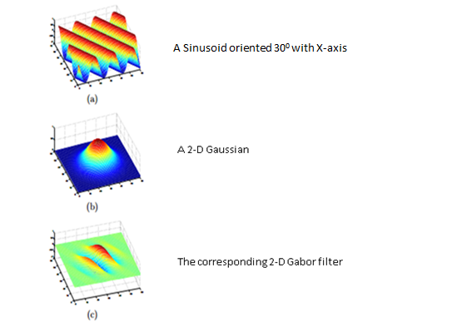
2D Gabor Filter

Slide 5
2D Gabor Filter
The sinusoid has been spatially localized.
In practice to analyze texture or obtain feature from image, a bank of Gabor filter with number of different orientation are used

Slide 6
Gabor filter application
To better understand what each filters detect in input image, consider a simple white circle in black background.

Slide 7
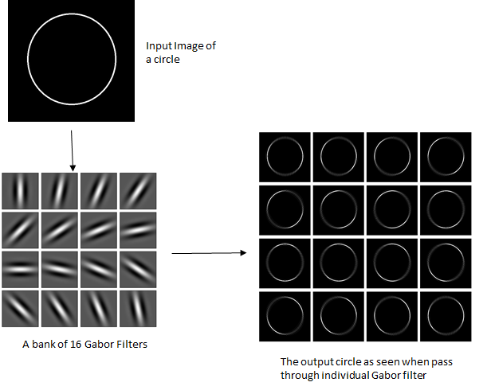
Gabor filter application

Slide 8
Gabor Filter application
When this image is passed through each filter in the filter bank, the edge of the circle which gets detected is the edge oriented at an angle at which the Gabor filter is oriented.

Slide 9
Different parameters that controls the shape & size of 2D Gabor filter
There are certain parameters that controls how Gabor filter will be and which features will it respond to.
A 2D Gabor filter can be viewed as a sinusoidal signal of particular frequency and orientation, modulated by a Gaussian wave.
The filter has a real and an imaginary component representing orthogonal directions.
The two components may be formed into a complex number or used individually.

Slide 10
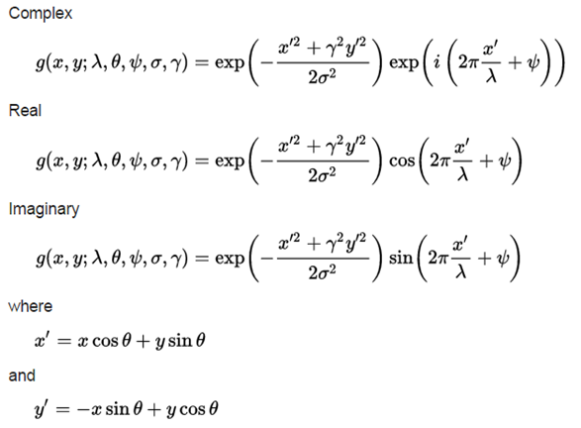
Equations of 2D Gabor filters
In the above equation,
λ — Wavelength of the sinusoidal component.
Ө — The orientation of the normal to the parallel stripes of Gabor function.
Ψ — The phase offset of the sinusoidal function.
σ — The sigma/standard deviation of the Gaussian envelope
ɣ — The spatial aspect ratio and specifies the ellipticity of the support of Gabor function.

Slide 11
Role of Gabor parameters for feature extraction
The five parameters controls the shape and size of the Gabor function
Lambda – wavelength
Theta- orientation
Gamma- aspect ration
Sigma - standard deviation of the Gaussian function
Phi – phase offset

Slide 12
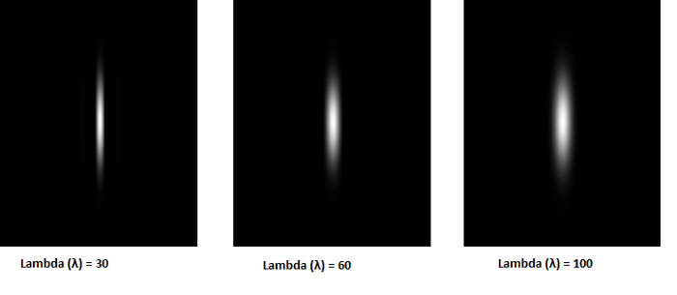
Parameter Lambda in Gabor filter
The wavelength governs the width of the strips of Gabor function.
Increasing the wavelength produces thicker stripes and decreasing the wavelength produces thinner stripes.
Keeping other parameters unchanged and changing the lambda to 60 and 100, the stripes gets thicker.

Slide 13
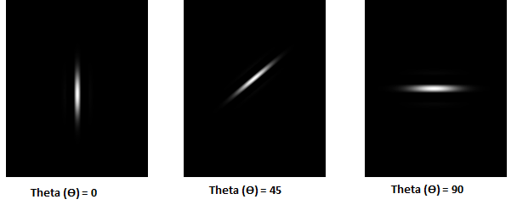
Parameter Theta in Gabor filter
The theta controls the orientation of the Gabor function.
The zero degree theta corresponds to the vertical position of the Gabor function.

Slide 14
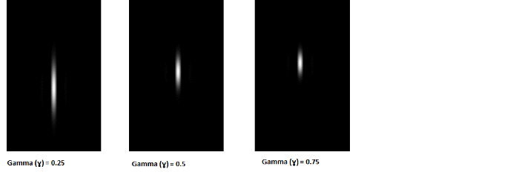
Parameter Gamma in Gabor filter
The aspect ratio or gamma controls the height of the Gabor function.
For very high aspect ratio the height becomes very small and for very small gamma value the height becomes quite large.
On increasing the value of gamma to 0.5 and 0.75, keeping other parameters unchanged, the height of the Gabor function reduces.

Slide 15
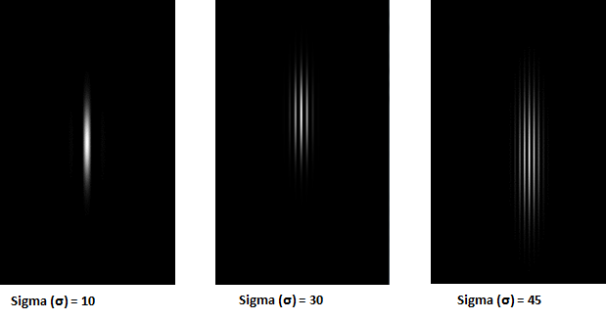
Parameter Sigma in Gabor filter
The bandwidth or sigma controls the overall size of the Gabor envelope.
For larger bandwidth the envelope increase allowing more stripes and with small bandwidth the envelope tightens.
On increasing the sigma to 30 and 45, the number of stripes in the Gabor function increases.

Slide 16
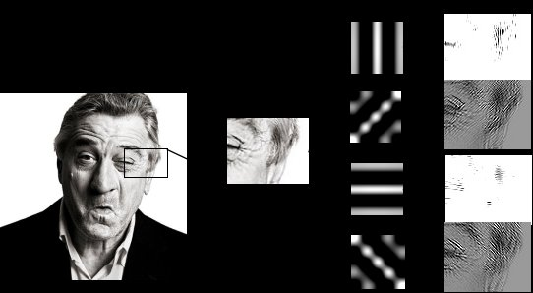
Face Detection Application
Demonstration of Gabor filter bank
Responses with kernel size = 5 applied to an image.
Responses for four orientations (θ = 0, π/4, π/2, 3π/4) are shown.

